Slide 1
Rapla Calendar
Enhancement: Faster Resource Selection
By: Connor Jackson & Adam Claxton

Slide 2
What is Rapla?
Rapla is a software application used for organizing your daily life events.
Think: an electronic calendar!
You can create events, which are like going to lunch, going to class, etc.
You can create resources, such as:
Location of event
People going to be at event
Goals of event
…any kind of attribute an event can possibly have.

Slide 3
Problem: Inadequate Filter Feature
Rapla currently has a built in filter feature, for both events and resources.
You can check off in a popup window which resource you want to filter, and type in filter text.
Although, say you only want to filter by location name…
You have to manually uncheck every other resource type first
For a real world application, there could be a lot of resources...
This is unideal and tedious to the user environment

Slide 4
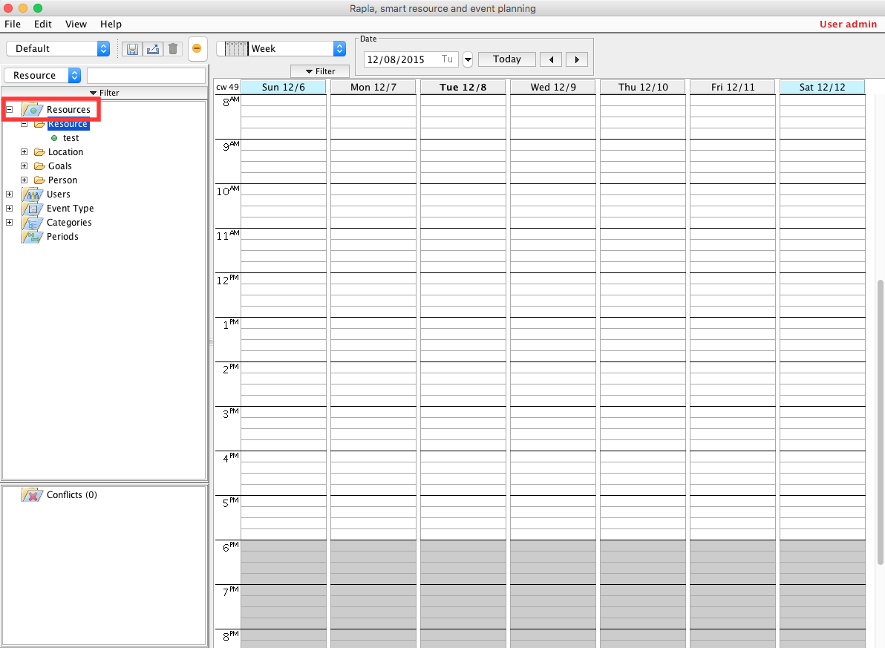
Quick Note About Rapla
When you start Rapla, the calendar doesn’t display any events.
You have to click on the folder icon for resources (highlighted red) to make all events show up in the beginning.
Please note, Rapla comes this way, and this was not within the requirements of our enhancement choice.

Slide 5
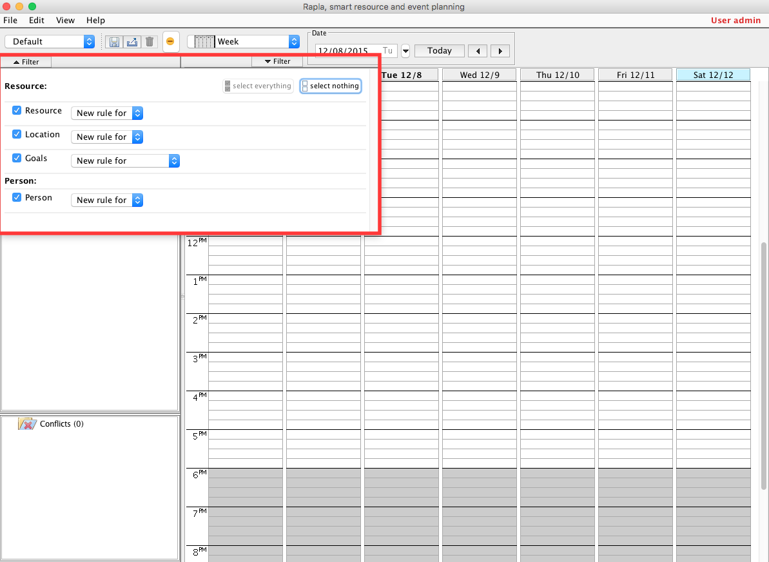
How Rapla Chose To Implement Resource Filter
You can click on the filter button, and thus select filter options.
Note, that to make an entirely effective “search” you have to unclick all resources you don’t care about.
This is tedious!

Slide 6
Our Enhancement: Faster Resource Search
We will eliminate the fact that users have to uncheck resources they don’t care about.
They will choose from a drop box of resource types (implemented via JComboBox) to determine their search type.
They will type into a text field next to the drop box (implemented using a JTextField) and press enter when their search criteria is entered.
Our search feature performs searches in an OR search fashion.

Slide 7
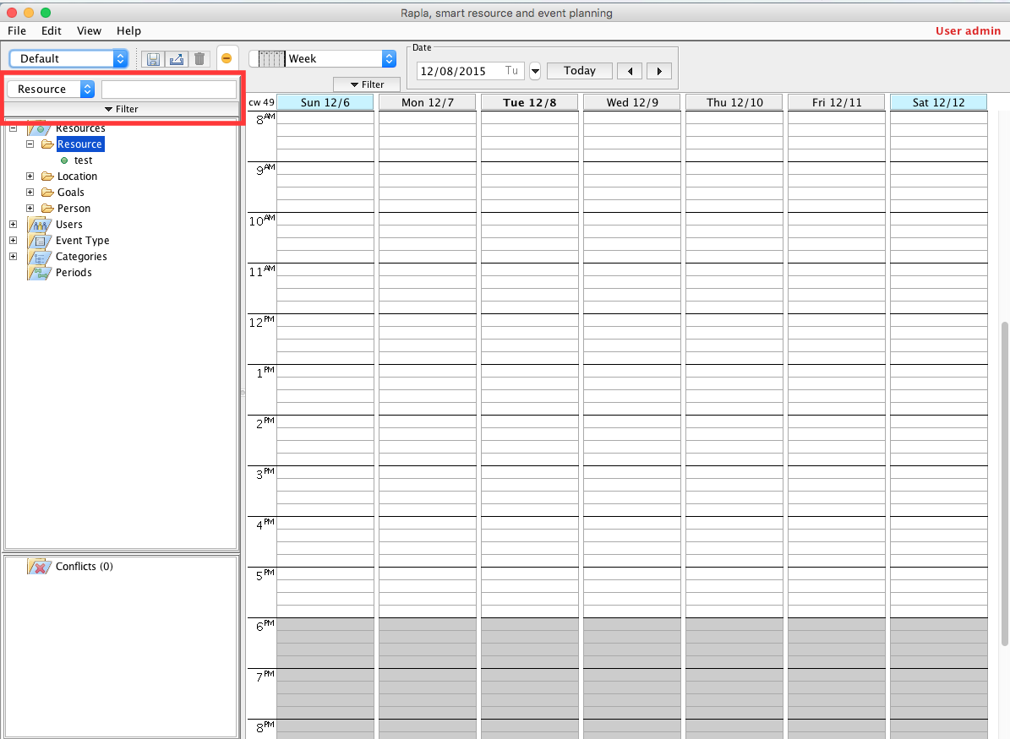
Our Enhancement: User Interface
We decided to put the drop box and text field around the same area as the filter button.
Here is where searches will be performed by a user.

Slide 8
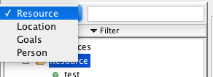
Our Enhancement: Dropbox Functionality
Users will click on this drop box to choose which resource they want to search by.
Our implementation populates the drop box with values based on what Rapla currently holds in its query.

Slide 9

Our Enhancement: Text field Functionality
Once the user selects a resource type to search by, they will type in what they want to search for, and then press enter to perform a search.
Rapla was originally designed to do a search by each keystroke.
This isn’t how search usually works… so we made the action perform on the enter key, not just every key.

Slide 10
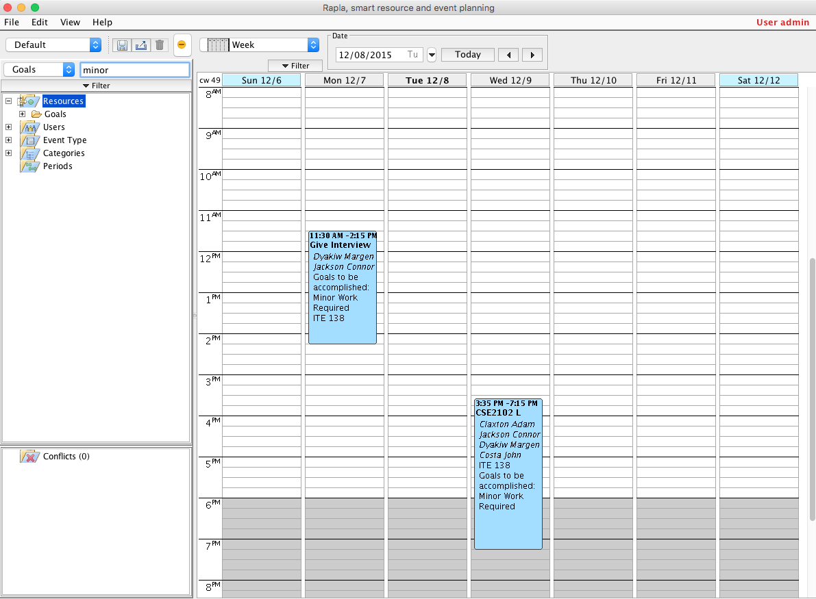
Our Enhancement: An Actual Search!
Once you press enter, a search is made!
The only results that show are ones based on the search criteria (goals, minor)

Slide 11
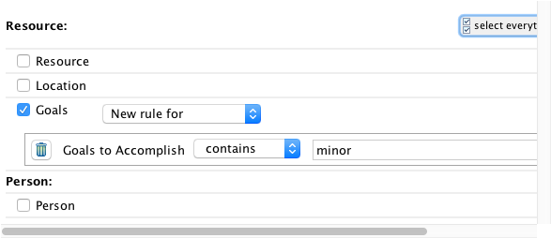
Our Enhancement: Theory
By manipulating multiple classes in the project, and by contributing our own classes, we were able to “simulate” a user filter based on a simple search.
If you click on the filter button, the image to your right will show.
We went through and automated the process of unchecking checkboxes the user doesn’t want to use, and filled in the search criteria for them.
Lets say the user wants to search by multiple resource types; we still have the filter button in the user interface, they can still do that! Searching by one resource is just made easier.

Slide 12
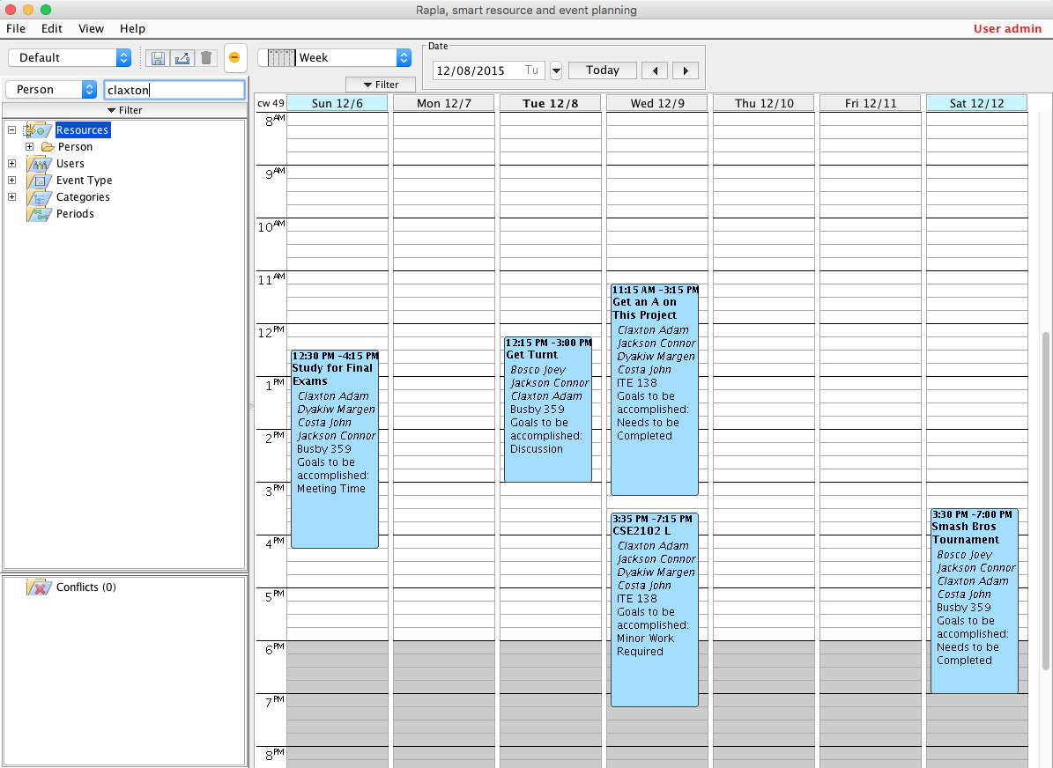
Our Enhancement: Searching Resources With Multiple Attributes
Say you want to search for events with someone with the last name “Claxton” associated with it.
Our search will fill in rules as follows:
First name contains Claxton
OR surname contains Claxton
OR email contains Claxton
In Rapla’s previous implementation, search amongst different resource attributes performed as an AND search; we found it more optimal to adjust that to an OR search.

Slide 13
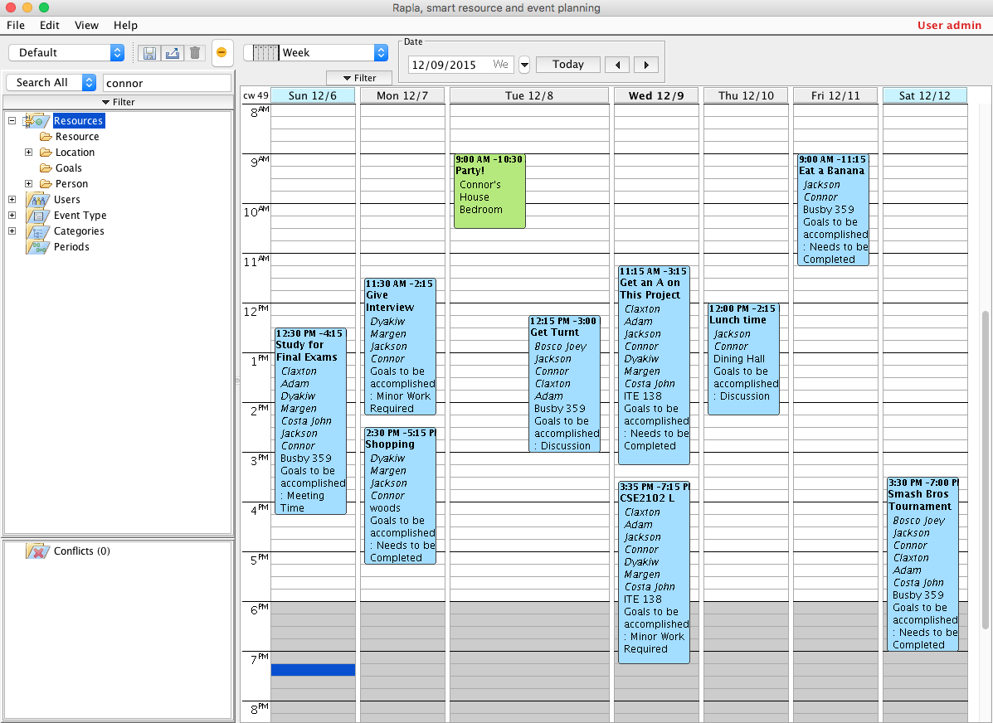
Our Enhancement: Searching All Resources
Searching for all resources would be tedious with the already existing filter feature always.
Imagine you wanted to show events where the location contains Connor (Connor’s House) or events with the name Connor (Connor Jackson). You’d have to click on quite a few rule boxes…
But not anymore! We have a search all functionality built into the drop box as the first selection.

Slide 14
Our Enhancement: The Future
We thought that working with Rapla was fun, in the process of really getting to understanding how to properly reverse engineer a software project.
We think it would be cool to extend the easy search feature to include a search criteria value of “event name” so that you can also search for events by their name!
We figured that’s the most common type of search in a calendar application, so if we developed a proper search function, why not extend it to that?

Slide 15
How Did We Reach This Solution?
Many hours reading the source code directly.
Careful planning, to make sure we didn’t leave everything until the last minute.
MaintainJ diagrams ended up being a helpful resource, to pinpoint which methods were called based on certain filter functions (to learn how the current implementation worked)
The Eclipse built in debug-marker methodology helped a lot, to trace through example runs to learn how the code currently worked, and to see how to fix issues in our own code.

Slide 16
Thanks For Checking Out The Enhanced Rapla!

